Slide 1

Viral Images!
System of Integrations
for the course of Enterprise Application Integration
Authors
Swastik Nayak
Anil Mathew
Filipe Capela
Mark Soelman

Slide 2
Table of contents
System Context
Integrated Systems
Tiered Architecture
Design Decisions
Architectural Diagrams
Demo

Slide 3

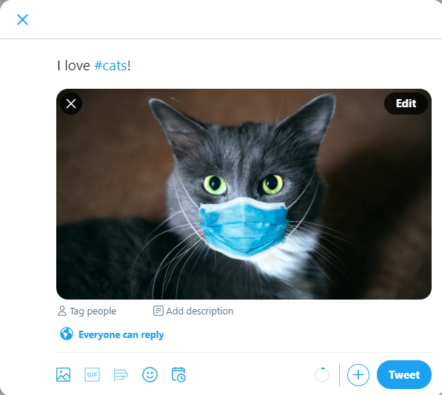


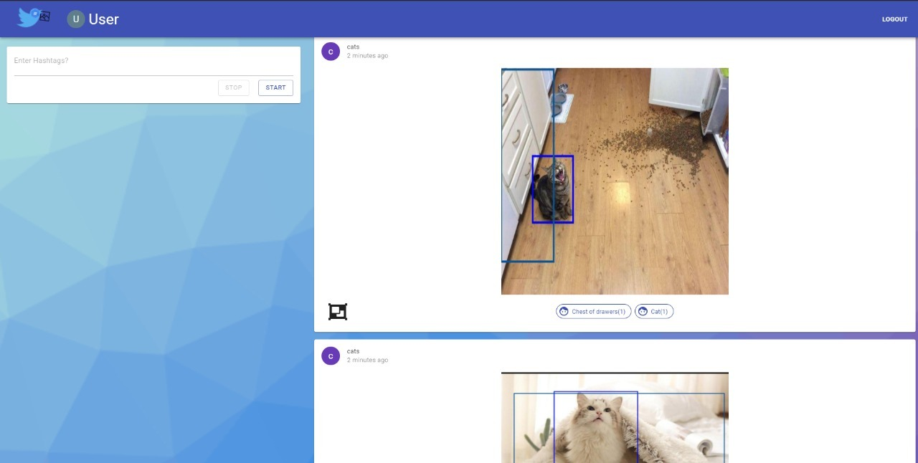


System Context
1. Monitor #cats
3. Annotating
2. Internet posts image
5. Frontend!
4. Logging

Slide 4



Integrated Systems

Slide 5
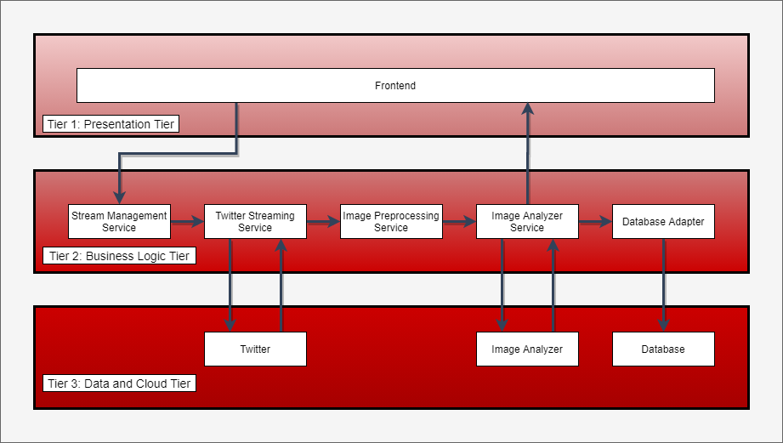
Tiered Architecture

Slide 6
Problem #1
How to get from Twitter -> Output ?
Assumptions/Constraints
Multiple processing stages required
Transferred data (images) may be large
Analysis may take a long time

Slide 7
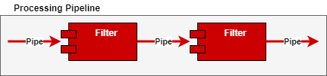
Integration Style in-between processing pipeline components (Pipes and Filters)
Chosen
Pipes and Filters
Messaging
Point-to-Point Channel
Document Messages

Slide 8
Problem #2
When to start and stop data ingestion from Twitter?
Assumptions/Constraints
N users watch #hashtag -> 1 data ingestion on #hashtag
0 users watch #hashtag -> 0 data ingestion on #hashtag
Users are unreliable. Will not always click “stop”
What if… Twitter ingestion app crashes?

Slide 9
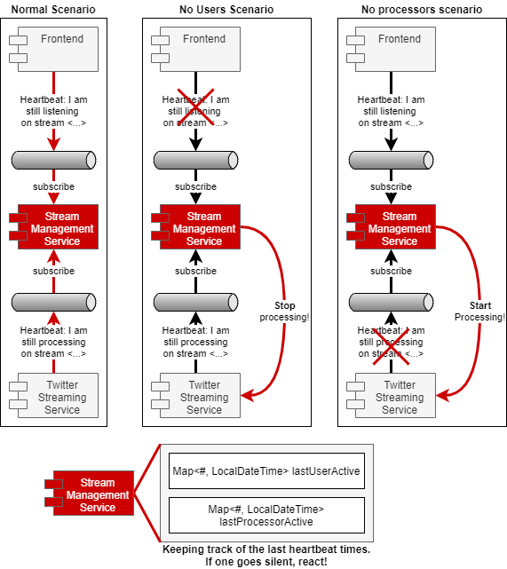
Pipeline Lifecycle Management
Chosen
Observer
Event Messages
Splitter
Command Message
Correlation Identifier
Idempotent Receiver
Content-based Router

Slide 10
Problem #3
Decoupling between Messaging <-> Business Logic
Assumptions/Constraints
Business logic should be 100% agnostic to communication
Messaging System may be replaced

Slide 11
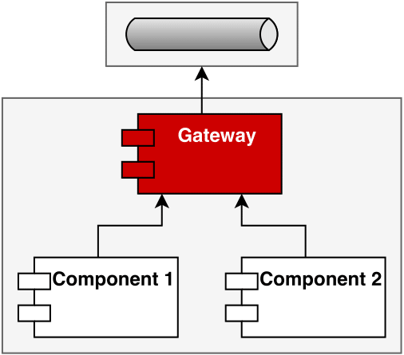
Coupling between code and messaging system (Gateway)
Chosen
Gateway

Slide 12
Problem #4
Agreement on Data Format
Assumptions/Constraints
Components communicate data
Different data formats used throughout application
Applications may need to modify data formats
Applications should allow independent compilation

Slide 13
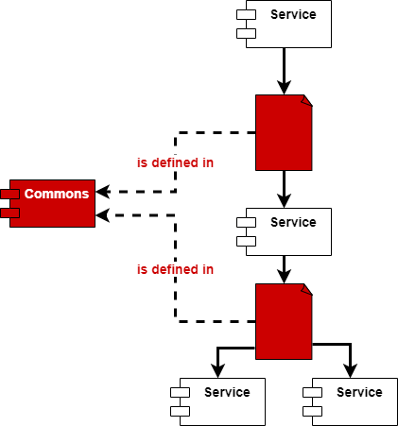
Cross-application data model sharing (Canonical Data Model)
Chosen
Canonical Data Format

Slide 14
Design Decisions
Integration Style in-between processing pipeline components (Pipes and Filters)
Pipeline Lifecycle Management
Coupling between code and messaging system (Gateway)
Cross-application data model sharing (Canonical Data Model)
Delivering Analysis Results to the Frontend (Publish-Subscribe)
Filtering results and removing noise (Content Filter)
Object Detection in images (Content Enricher)

Slide 15
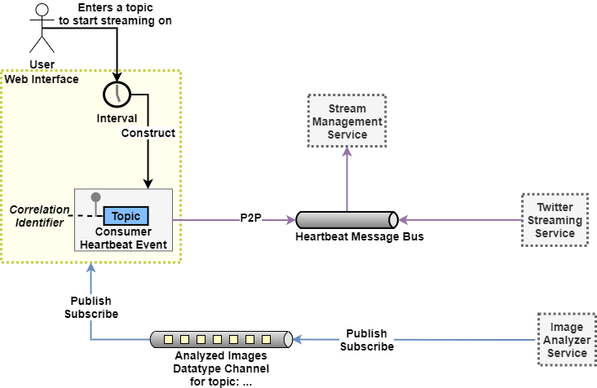
Architectural Diagram
(Web Interface)

Slide 16
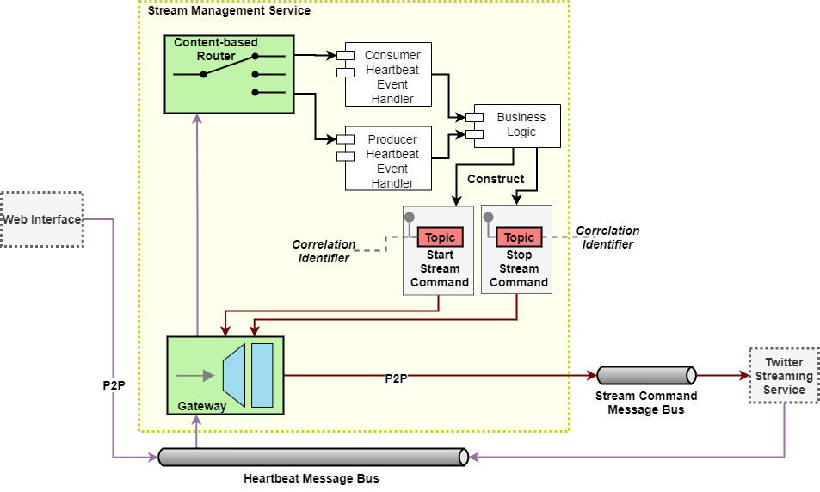
Architectural Diagram
(Stream Management Service)

Slide 17
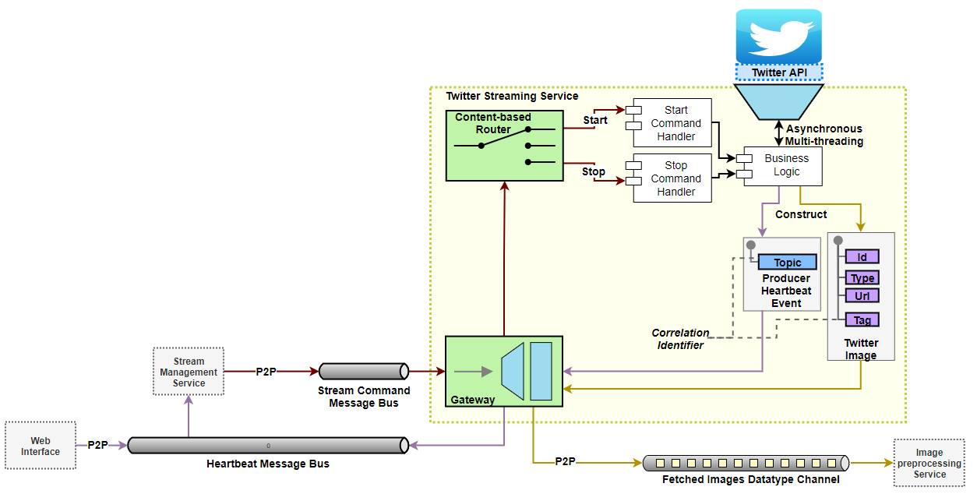
Architectural Diagram
(Twitter Streaming Service)

Slide 18
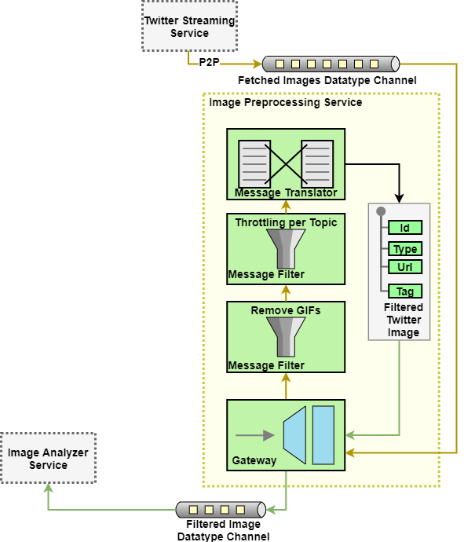
Architectural Diagram
(Image Preprocessing Service)

Slide 19
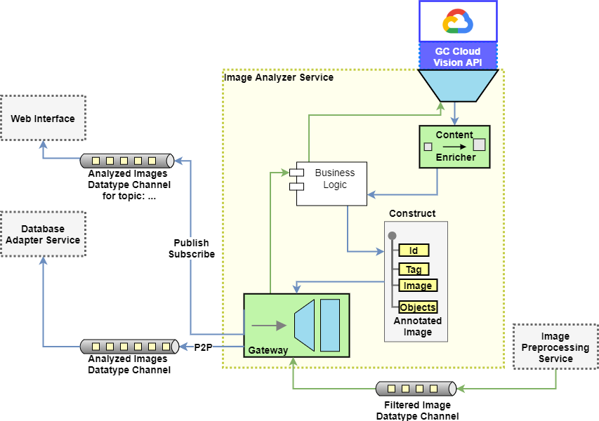
Architectural Diagram
(Image Analyzer Service)

Slide 20
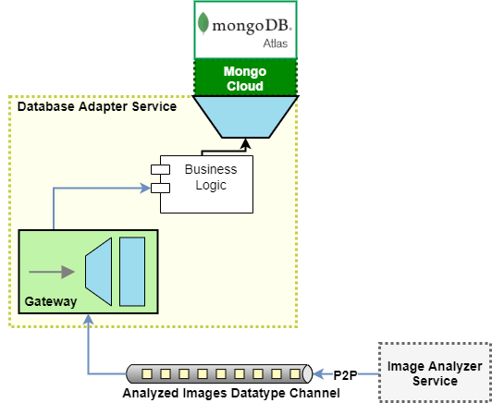
Architectural Diagram
(Database Adapter Service)

Slide 21
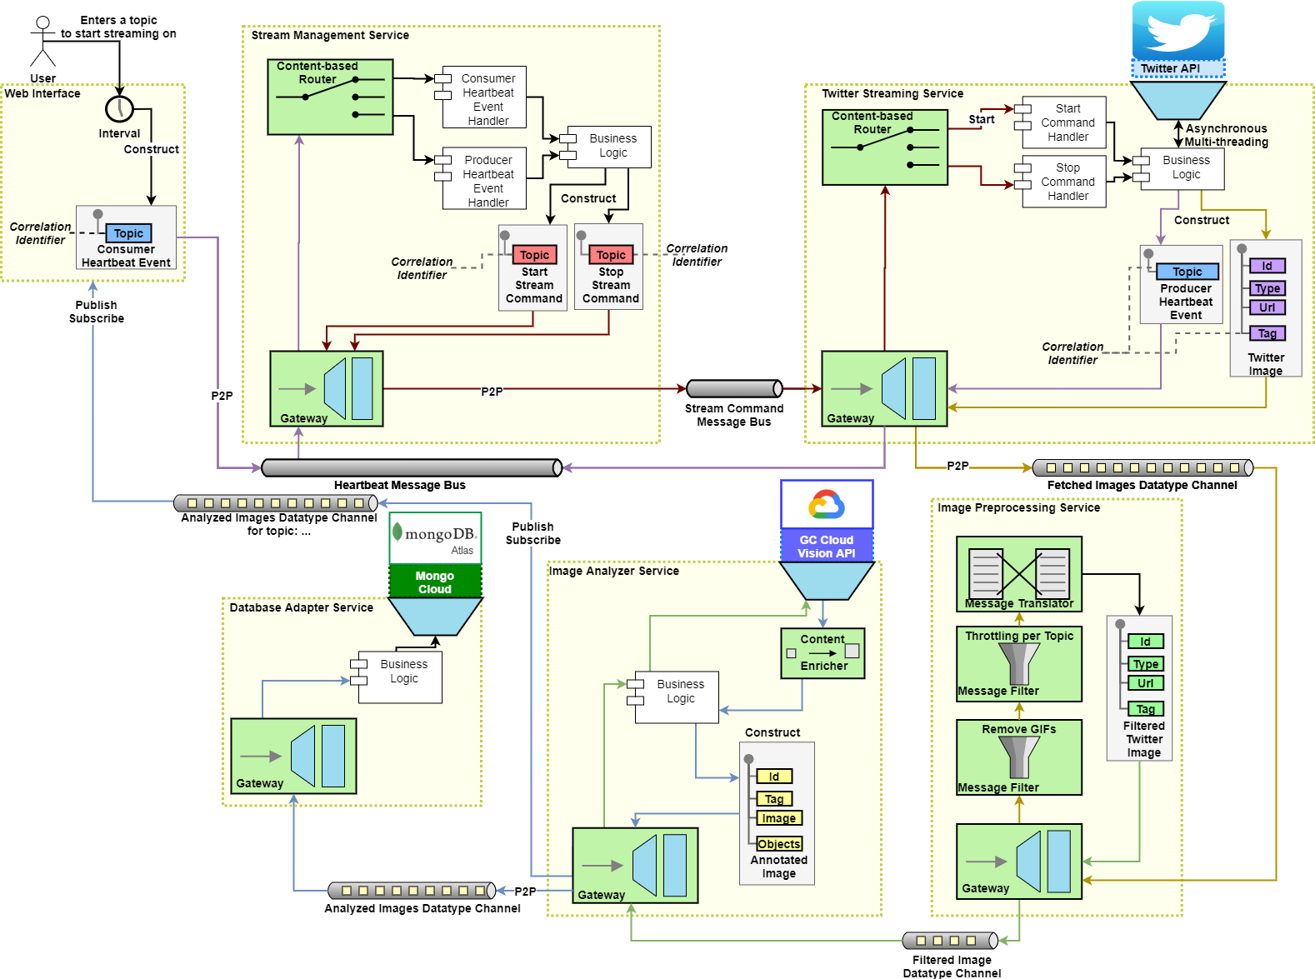
Architectural
Diagram

Slide 22



Demo

Slide 23





Technologies

